Slide 1
Sustainable Housing - UK
Shawm House
(D. Martini s8097697)
Architect: Mawson Kerr
Size: 274 m2 Completed: 2017

Slide 2

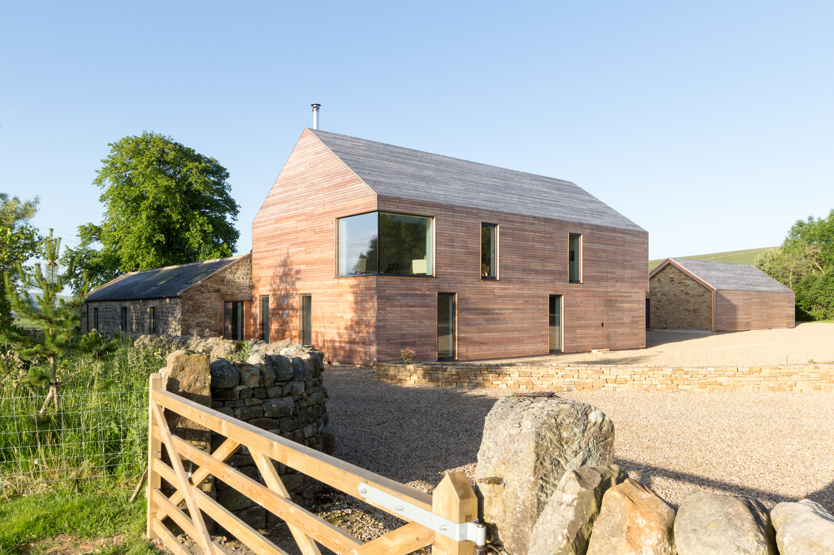
Shawm House - Reflection
Sustainable Housing has been chosen as the group theme with each team member selecting case studies from differing countries to demonstrate how sustainable methodologies have been adopted internationally.
Shawm House is located in the United Kingdom and consists of a new build which incorporates an existing stone stable and stone wall. Passivhaus principles have been employed and the result is a well designed and highly energy efficient home. Featuring rainwater storage, triple glazed windows and doors throughout, quality insulation, a mechanical heat recovery ventilation system and a solar photovoltaic system. Materials have been sourced locally, reducing transportation costs and greenhouse gas emissions. The home also incorporates a small elevator which serves to future-proof the build for the retiree owners.
Incorporating an existing building into the new design demonstrates an important consideration to both sustainability and sustainable housing - to preserve, not waste, existing structures and to reimagine for future use. The considered design has saved the structure from ruin while also reducing land fill.

Slide 3
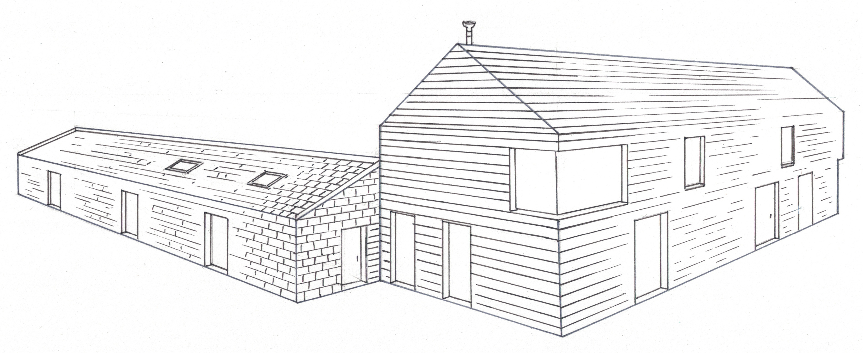
Shawm House
– Hand Drawn External Perspective

Slide 4
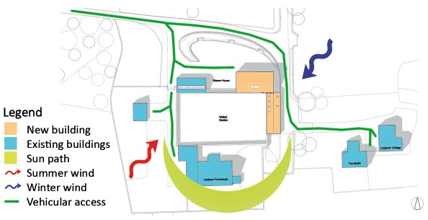
Shawm House
– Site Analysis Diagram

Slide 5
Shawm House - Model Making
Materials purchased
Tools
Balsa wood, 50 x 300 x 3mm
Balsa wood, 100 x 915 x 3mm
Match sticks
Cork, 300 x 400 x 3mm
Timber base
Textured paper, optional
Cutting mat, rulers, pencils, tweezers
Scalpel, stanley knife
uPVC glue, hot glue gun
Step 1 – prepare scaled floor plans and elevations
Step 2 – create wall, roofing, window and detail components
Step 3 – assemble and glue model
Step 4 – prepare model for final presentation

